Slide 1
The Role of the Lexical Analyzer in a Compiler
Principles of Compiler Design
Prepared by: Yeabsira Amare
January 2026
BahirDar University

Slide 2
Introduction to Lexical Analysis
Lexical Analyzer (also called Scanner or Lexer) is the first phase of a compiler.
It reads the source code character by character and groups them into meaningful sequences called lexemes.
Converts lexemes into tokens (abstract symbols) for the next phase.
Relevance: Simplifies input for the parser, removes unnecessary elements (whitespace, comments), and detects early errors.

Slide 3
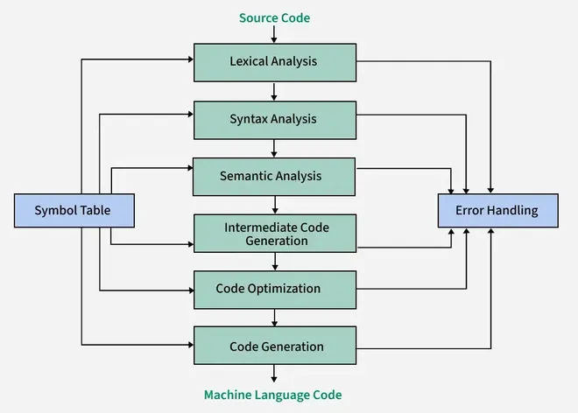
Position in Compiler Phases
Compiler Phases: Lexical Analysis → Syntax Analysis → Semantic Analysis → Intermediate Code Generation → Code Optimization → Code Generation.
Acts as an interface between source code and the rest of the compiler.
Outputs a stream of tokens to the Syntax Analyzer (Parser).
Interacts with Symbol Table for identifiers.

Slide 4
Main Responsibilities
Read source code from left to right, character by character.
Identify and generate tokens from lexemes.
Remove whitespace, comments, and newlines.
Detect lexical errors (e.g., invalid characters).
Correlate errors with line numbers.
Improve compiler efficiency and portability.

Slide 5
Core Concepts: Tokens, Lexemes, Pattern
Lexeme: Sequence of characters matching a pattern (e.g., "position").
Token: Pair of <token-type, attribute-value> (e.g., <ID, pointer to "position">).
Pattern: Rule (regular expression) describing possible lexemes for a token.
Common Token Types:
Keywords (e.g., if, while)
Identifiers (variable names)
Operators (+, -, ==)
Literals (numbers, strings)
Punctuators (;, {, })

Slide 6
Practical Example
Source Code Snippet:
position = initial + rate * 60;
Generated Tokens:
<ID, "position">
<ASSIGN, "=">
<ID, "initial">
<PLUS, "+">
<ID, "rate">
<MULT, "*">
<NUMBER, "60">
<SEMICOLON, ";">

Slide 7
Real-World Applications & Importance
Essential for all compilers (GCC, Clang, Javac).
Used in interpreters, code editors (syntax highlighting), and tools like search engines or NLP.
Tools: Lex/Flex for generating lexical analyzers.
Importance: Reduces complexity for parser, enables early error detection, enhances compiler portability.

Slide 8
Conclusion
Lexical Analyzer is crucial as the first phase, converting raw code into structured tokens.
Key benefits: Error handling, simplification, and preparation for syntax analysis.
Understanding it is fundamental to compiler design and efficient code processing.

Slide 9
References
Aho, A.V., Lam, M.S., Sethi, R., & Ullman, J.D. (2006). Compilers: Principles, Techniques, and Tools (Dragon Book).
GeeksforGeeks: "Introduction of Lexical Analysis" and "Working of Lexical Analyzer".
Tutorialspoint: "Compiler Design - Lexical Analysis".

